Slide 1
College Enrollment, Graduation, & Employment
Aparna, Brandi and Carter

Slide 2

Motivation and Summary
Goal:
Our project goal is to compare enrollment and completion rates to employment in the US over time.
Key Questions:
Is there a relation between unemployment rate and enrollment or completion rates?
As employment rates decrease, do enrollment rates increase in response?
Can we predict enrollment rates based on current economic trends?
Answers:
We were able to visualize a correlation between enrollment and unemployment rates over time.
Similarly, we’re able to see a relationship between enrollment and completion rates.
We would need more data than what is available to determine cause-and-effect relationship and/or a predictive trend.

Slide 3
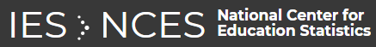
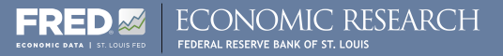
Questions & Data
Based on our questions, what types of data do we need to locate?
Economic data, including unemployment rates
Educational data, including enrollment and completion trends
Data Sources:
National Center for Educational Statistics
Federal Reserve Economic Data

Slide 4

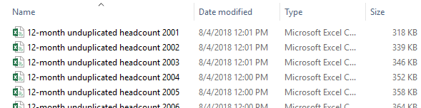
Data Cleanup & Exploration - NCES
NCES Exploration
Many different ways to pinpoint your data needs (Custom data files)
User-friendly site, when you know exactly what you need
NCES Data Files Obtained
Separate enrollment files per year (2001-2017)
Separate completion (a.k.a., degrees awarded) files per year
(2001-2017 for enrollment, 2005-2017 for completions)
Merged using “copy*combine.csv” command line
Cleanup
Removed extraneous columns
Removed rows with missing data
Problems
Many holes in the completion data

Slide 5
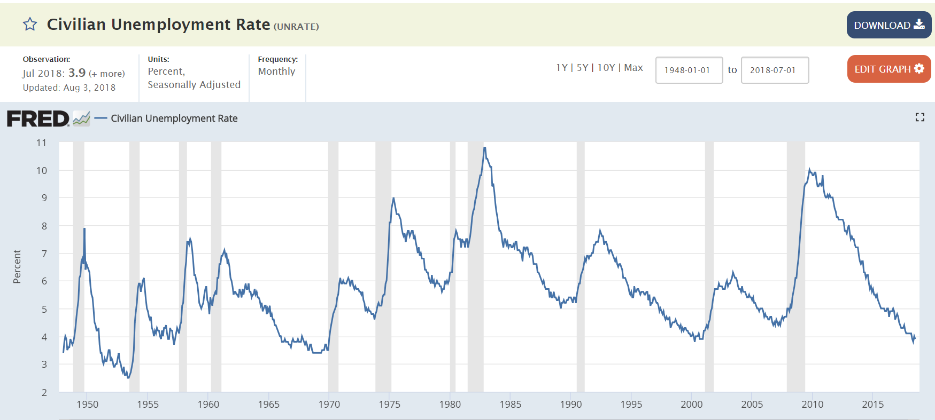
Data Cleanup & Exploration - FRED
FRED Exploration
Economic data
>500k data series
FRED Data Files Obtained
Monthly unemployment (2000-2018)
Monthly labor force participation (2000-2018)
Weekly unemployment claims (2000-2018)
Cleanup
Removed extraneous columns
Averaged data annually to match NCES data
Problems
Different frequency of observations than NCES data

Slide 6
Data Analysis
Group data by year
Calculated the average Rate of Change
Visualized the data via MatPlotLib line, bar, and pie charts
Layered the visuals to look for correlations
Used excel to look for regression values

Slide 7
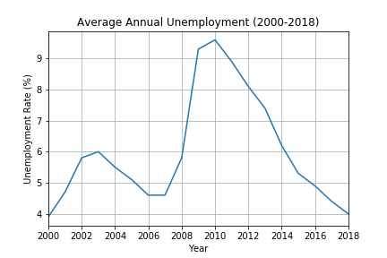
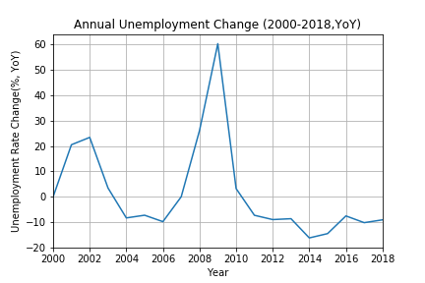
Unemployment Data

Slide 8
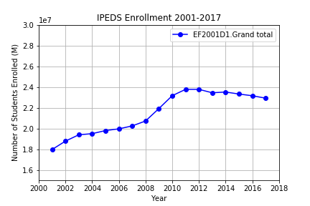
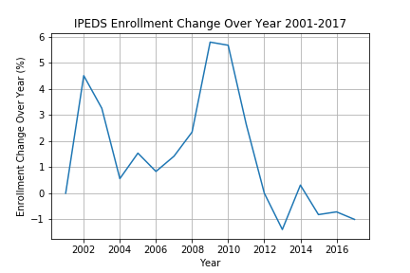
Enrollment Data

Slide 9
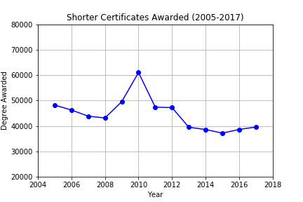
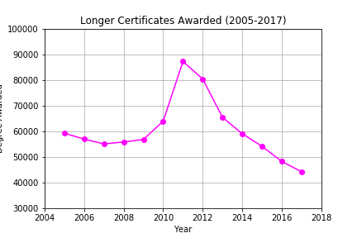
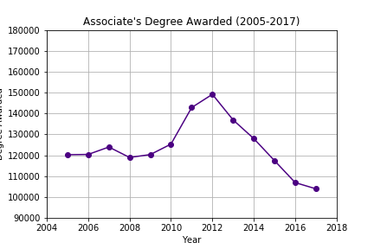
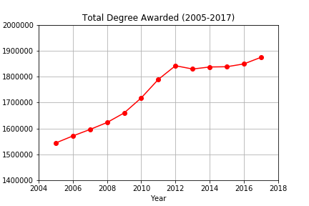
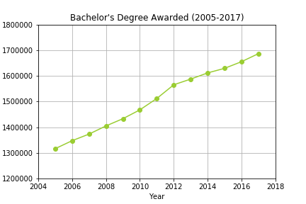
Trend in Degrees Awarded
Increase in short term degrees appear to correlate with increase in unemployment rate

Slide 10
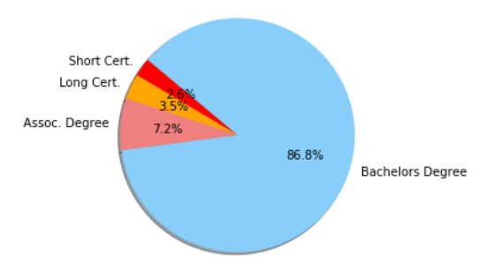
Summary of Degrees Awarded
On average ~87% of total graduates receive a Bachelor's Degree

Slide 11
Findings

Slide 12
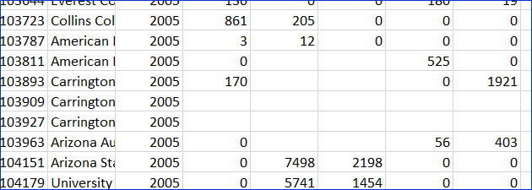
Post Mortem
Difficulties
Limited data
Dangers of using dropna
With .dropna, deleted ~11,000 rows!
Convert NaN to ‘0’ value instead.
Snags with visualizing the data
Next Steps
How the number of degrees awarded effect the economy
Compare textbook sales to enrollment rates and total institution counts

Slide 13
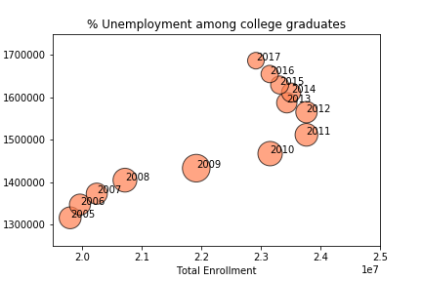
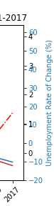
Visualization troubles

Slide 14
Questions?

